Slide 1
Designing a wireless transmitter and receiver to transmit analogue data
Munasinghe S A D L (AE133)
Supervisor :- Prof. D.U.J. Sonnadara
Mr. G. D. Illeperuma
Notes:
My project is design a system to transmit analogue data using wireless technique. So I designed a Wireless transmitter and a receiver for that under the supervision of :- Prof. D.U.J. Sonnadara and Mr. G. D. Illeperuma.

Slide 2
Introduction
Long distance communication is impractical with wired communication techniques.
The wireless transmission has many advantages including long distance.
The wireless telecommunication, such as radio, VHF and UHF are frequently used in most of modern applications.
The selected wireless transmission technique for this project is the frequency modulation.
Notes:
1. If we consider the data transmission techniques, we have two basic types.
2. One of them is wired communication and other one is wireless communication.
3. When it is required to transmit data over the long distance, the wired communication is not suitable for that.
4. The solution is wireless communication.
5. Modern day we can see various type of wireless techniques. Specially wireless Digital transmission techniques like RS 232 protocol.
6. But if we talk about analogue data transmission, the radio and TV broadcasting come into our mind directly.
7. Frequency modulation is the major technique which is used for all of these applications.
8. So I selected this FM as my wireless transmission technique.

Slide 3
Objectives
Design, implement and test wireless transmitter/ receiver to transmit analogue data
Transmit and Receive the analogue data without ADC/DAC conversion
High resolution
Higher accuracy
Low response time
Low cost
Notes:
Today many applications use ADC and DAC, although they are operated with analogue data.
The main objective is this project, design a system to transmit the analogue data without using of ADC and DAC.
Theoretically this techniques has high resolution.
It is expected high accuracy of the transmitted data.
Respond time is a crucial thing in this type of system. But this system was designed for slow varying data transmission.
Finally It was expected to complete the project with law budget.

Slide 4

Overall Design
The system works on four main circuits.
VFC (Voltage to frequency converter) circuit
FM transmitter
FM receiver (FM radio)
FVC (Frequency to voltage converter) circuit
Sub circuit – Sine to Square wave converter
Notes:
Lets see the overall design of the system.
Earlier I designed the system with main four circuit. you can see them in the top of the list here. Additionally another sub circuit was constructed with the unexpected issue.
You can have a clear idea about my project with this block diagram.

Slide 5
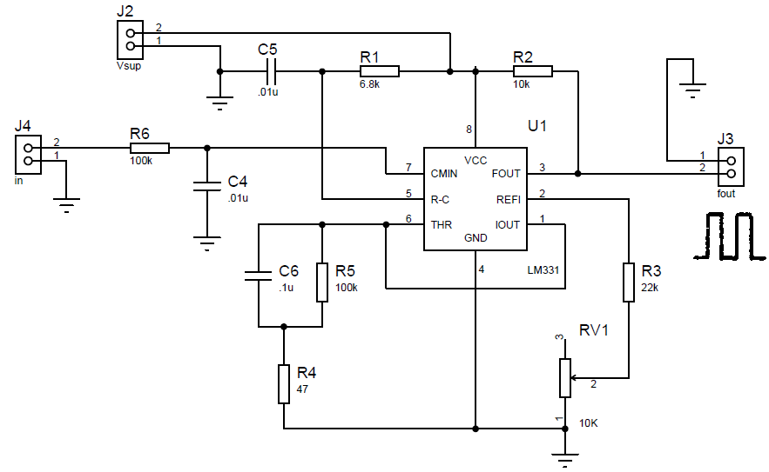
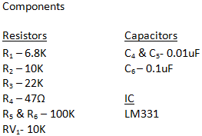
Circuit Construction VFC circuit

Slide 6
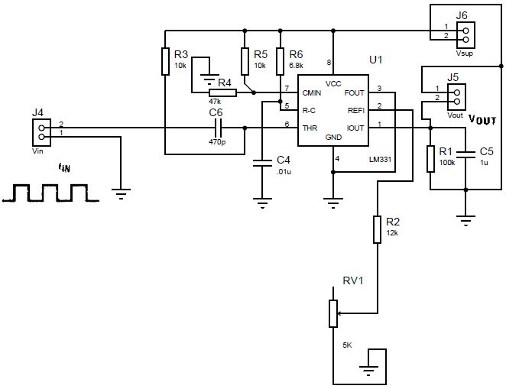
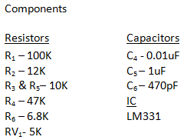
Circuit Construction FVC circuit

Slide 7
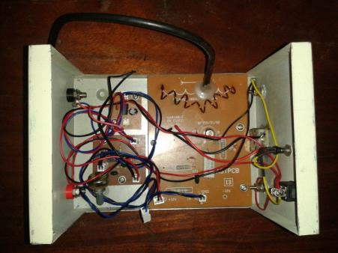
Transmission Phase
VFC and FM transmitter are the basic components in the transmission phase.
VFC – converts a given voltage input in to a square wave with frequency proportional to the voltage.
FM Transmitter - transmits the signal which is provided by the VFC.
Circuit arrangement in Transmission unit
Notes:
I told you, the transmission unit has two sub systems. First one is VFC. It convert the given voltage into the frequency of output signal. The output wave form is rectangular one.
Newly I have introduced a small modification to improve the input voltage range. It was success and now the VFC can operate over the range of 0 – 10.4 V with having a great linearity.
FM transmitter is used to modulate the signal and transmit this modulated signal in the radio frequency range of 88-108MHz.
This photo shows how I assembled the circuit into the transmitted unit.

Slide 8
Transmission Phase
FM Transmitter
When the positive pulse of this square wave is passed, the transmitter become active (ON).
The transmitter become non-active (OFF) when the voltage of the wave is below 0.7V.
Therefore with the exchanging of the positive and negative pulses of the square wave, the transmitter switches between ON and OFF states.
Notes:
When it is ON, it generates a unique signal by modulating the information in the signal with the carrier signal corresponding to the amplitude of the signal and then transmits the modulated signal.
Therefore, the ON and OFF state of the transmitter is equal to the frequency of the input square wave.

Slide 9
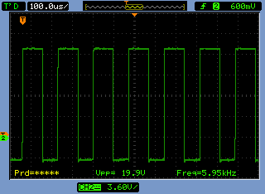
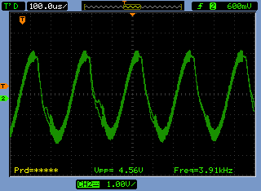
Receiver Phase
FM receiver circuit was used to capture the modulated signal.
Initially, although the direct coupling of VFC and FVC was successful, the wireless connection failed.
The characteristics of circuits were checked the requirements of each and every circuit for proper operation was investigated.
The problem was identified,
original signal output wave form of FM receiver
Notes:
Next I will move to receiver unit. There are three circuit in this unit.
The modulated signal is received by the FM radio. The VFC generates rectangular waveform.
You can see here the original information signal pattern which is generated by the VFC.
The FVC only responded to the square waves but you can see here the out put wave form of the FM receiver. It wasn’t a square wave so I had to construct an additional circuit called Sin to square wave convertor.

Slide 10
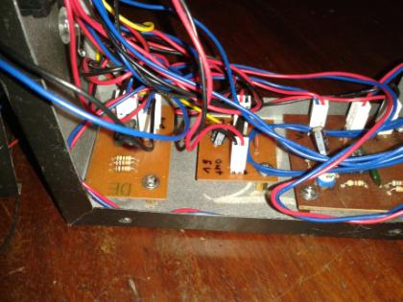
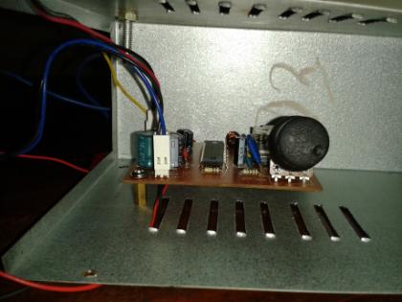
Receiver Phase
The FVC responded only to a square wave input. Therefore sinusoidal signal was converted to a square wave signal.
Conversion was carried out using a Sine to Square wave convertor circuit placed in the receiver unit.
Circuit arrangement in the receiver unit
Notes:
1. Here you can see how the circuits were placed in the receiver unit.

Slide 11
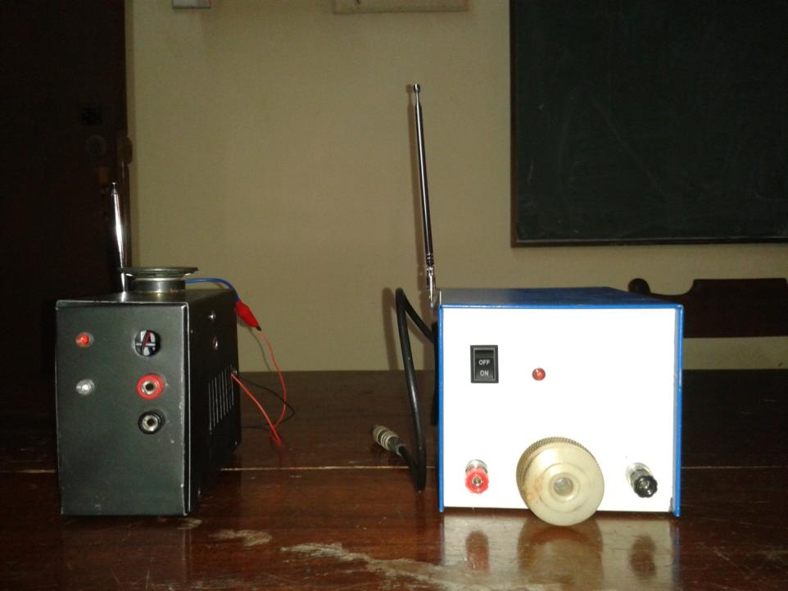

Slide 12
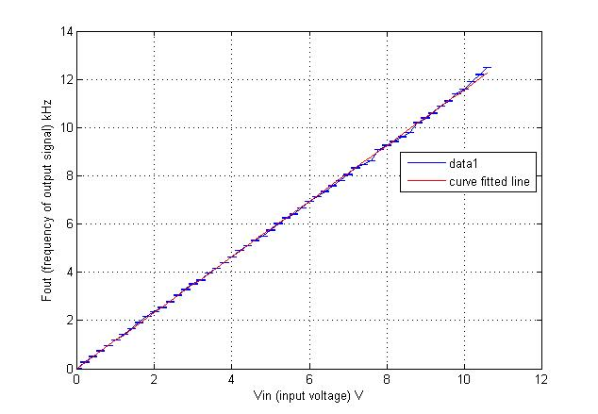
Performance of VFC
Gradient : 1.155
Intercept : 0.019
Sum of squares due to error (SSE) : 0.2341
RMSE : 0.0671
Correlation coefficient : 0.9998
Notes:
1. Curve fitting line in red.
These are the evidences about the Strong linearity of the VFC.
How much fit the data to the fitted line.
How much strong the relationship between Vin and Fout

Slide 13
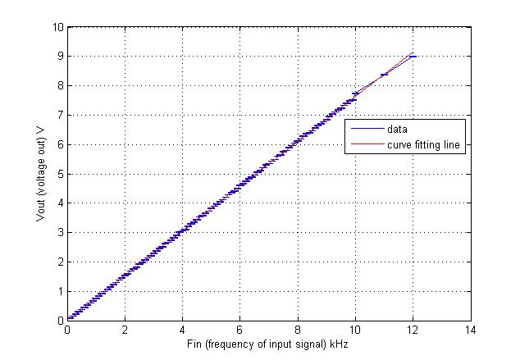
Performance of the FVC for rectangular input
Gradient : 0.763
Intercept : 0.049
Sum of squares due to error (SSE) : 0.0525
RMSE : 0.023
Correlation coefficient : 1
Notes:
This the performance of the FVC. You can see the curve fitting line in red also here.
This was also saw a great linearity. These are the evidence for that.

Slide 14
Performance of the System (Direct coupling)
Gradient : 0.763
Intercept : 0.049
Sum of squares due to error (SSE) : 0.0525
RMSE : 0.023
Correlation coefficient : 1
Notes:
This the performance of the FVC. You can see the curve fitting line in red also here.
This was also saw a great linearity. These are the evidence for that.

Slide 15
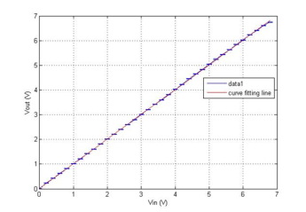
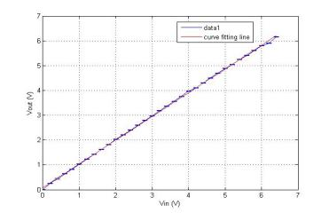
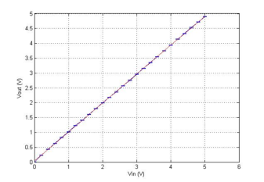
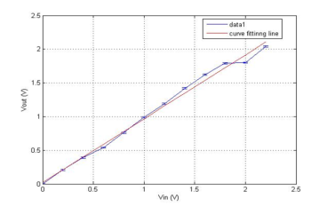
Performance of the System with the distance
Apart from1m
Apart from10m
Apart from 20m
Apart from 50m
Notes:
This the performance of the FVC. You can see the curve fitting line in red also here.
This was also saw a great linearity. These are the evidence for that.

Slide 16
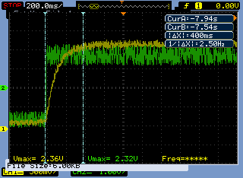
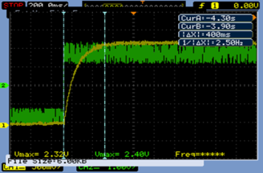
Response time
The latency is a crucial factor in a data transmission system.
The distance is not a factor which the latency is depended.
The low frequency square waves were used to determine the latency.
The green and yellow waves indicate the input and the corresponding output respectively.
All figures indicate that the system operates with a latency of 400 ms.
Frequency = 100 mHz
Frequency = 200 mHz

Slide 17
Conclusion
The system was successfully developed to work without using A/D and D/A conversion.
The system is capable of serving many clients simultaneously with a single transmitter unit.
Operating range of the system becomes narrower with the distance.
At this stage of the system the best performance is shown for short distances (less than 20 m) with considerable wide operating range (0 – 4.9V± 0.01). The recommended maximum working distance is 50m.
The uncertainty remains constant over the working range and it was ± 0.05V.
The response time of the system was good enough for many applications and it worked with a latency of 400 ms.
The component cost of this project was Rs. 2000.

Slide 18
Future plan
Introduce a powerful FM transmitter to expand the operating distance beyond 50 m.
Reduce response time by changing the operating methods (switching ON and OFF) of the transmitter unit.
Test the performance of the system under different background and weather conditions.

Slide 19
Thank you!!

